Slide 1
Attentive-recurrent network 和 D 部分 还需要再看看

Slide 2
Attentive Generative Adversarial Network for Raindrop Removal from A Single Image
Rui Qian1, Robby T. Tan2,3∗, Wenhan Yang1, Jiajun Su1, and Jiaying Liu1† 1Institute of Computer Science and Technology, Peking University, Beijing, P.R. China 2 National University of Singapore, 3 Yale-NUS College
Notes:
第一页

Slide 3
Abstract
Q：first the regions occluded by raindrops are not given。
Second, the information about the background scene ofthe occluded regions is completely lost for most part。
A：Our main idea is to inject visual attention into both the generative and discriminative networks。
our visual attention learns about raindrop regions and their surroundings。G will pay more attention to the area and D will be able to assess the local consistency of the restored regions。
Notes:
第二页

Slide 4
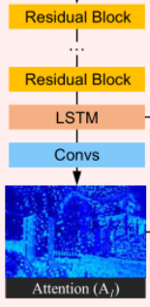
Introduction
This attention map is produced by a recurrent network consisting of deep residual networks (ResNets) combined with a convolutional LSTM and a few standard convolutional layers. We call this attentive-recurrent network.

Slide 5
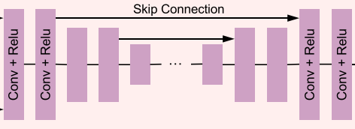
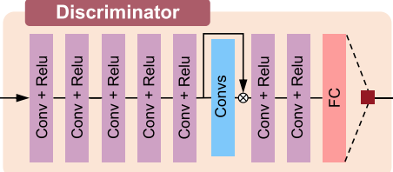
The autoencoder takes both the input image and the attention map as the input. To obtain wider contextual information, in the decoder we apply multi-scale losses.
we utilize our attention map to guide the discriminative network toward local target regions and validates the image both globally and locally.

Slide 6
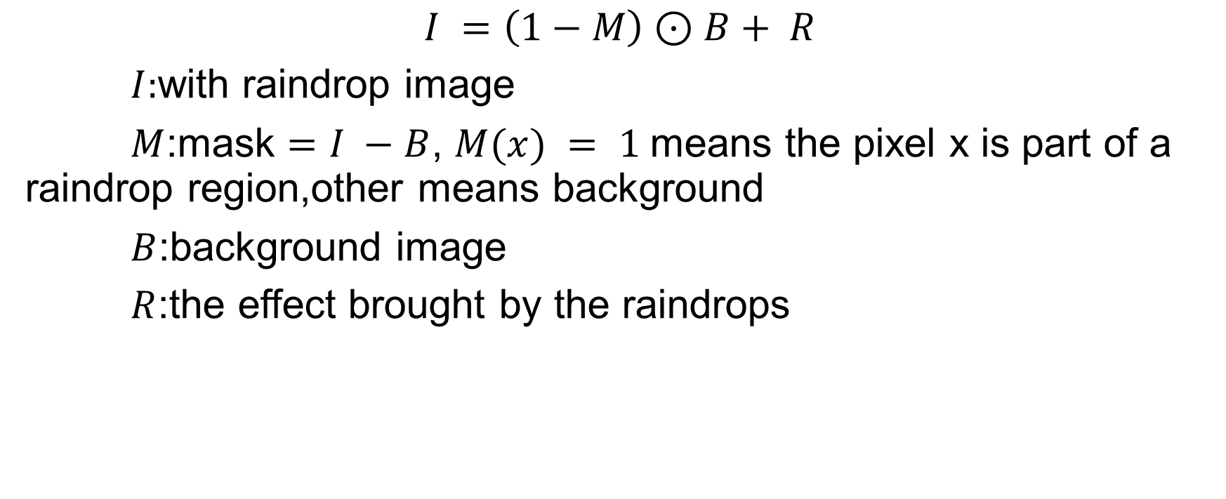
Raindrop Image Formation
$$I =\left(1−M\right)⊙B+ R$$
$I:$with raindrop image
$M$:mask $=I −B$, $M(x) = 1$means the pixel x is part of a raindrop region,other means background
$B$:background image
$R$:the effect brought by the raindrops

Slide 7
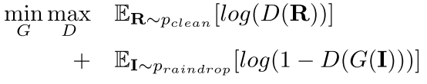
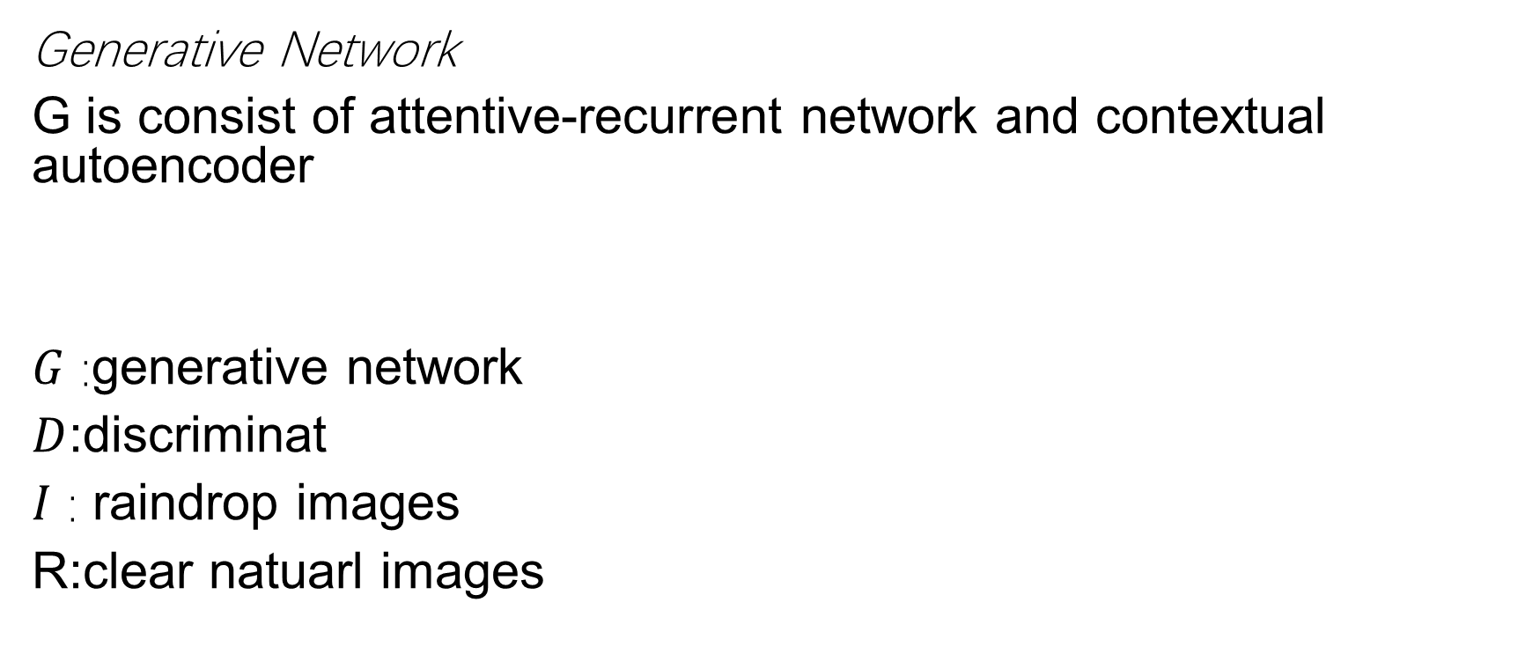
Raindrop Removal using Attentive GAN
Generative Network
G is consist of attentive-recurrent network and contextual autoencoder
$G$ :generative network
$D$:discriminat
$I$ : raindrop images
R:clear natuarl images

Slide 8
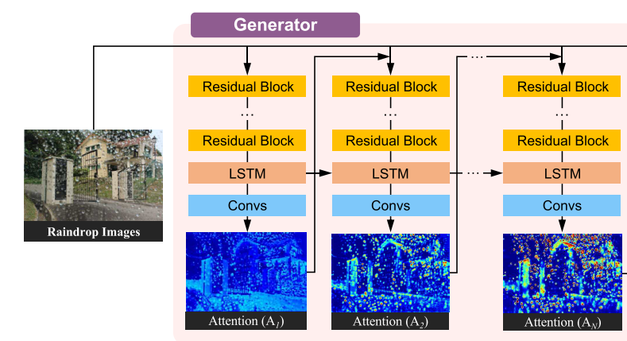
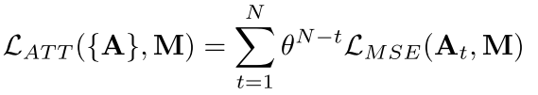
1.Attentive-Recurrent Network
attentivere current network is to find regions in the input image that need to get attention.

Slide 9
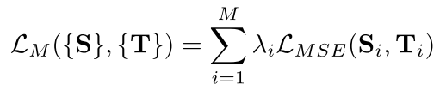


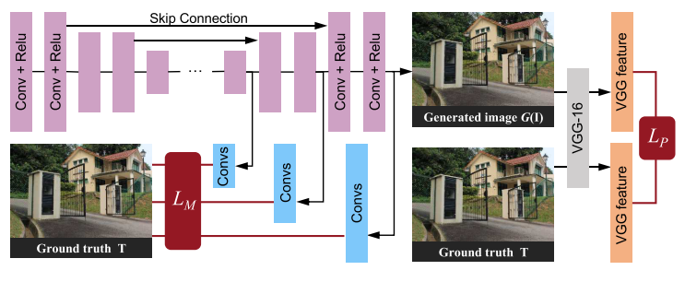
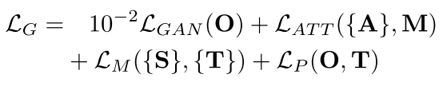
2.Contextual Autoencoder
The purpose of our contextual autoencoder is to generate an image that is free from raindrops
Multi-scale losses:
Perceptual loss:
Discriminative Network

Slide 10

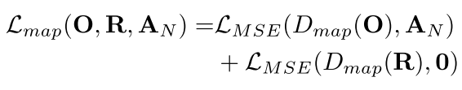
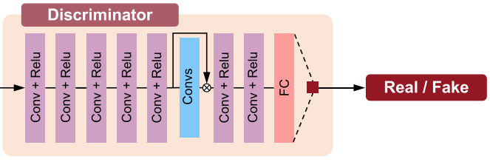
Discriminative Network
The purpose of our contextual autoencoder is to generate an image that is free from raindrops
Multi-scale losses:
Perceptual loss:

Slide 11
Conclusion
G produces the attention map via an attentive-recurrent network and applies this map along with the input image to generate a raindrop-free image through a contextual autoencoder。
Our novelty lies on the use of the attention map in both generative and discriminative network。

